Slide 1
Genetics Research Project
Each student will prepare a written research paper due on Feb 8-9 on their approved genetic disease (instructions and grading rubric are posted!)
During the 4th quarter, students will follow-up this research paper with the creation and presentation of a creative piece about their genetic disease (and hopefully a 3D-printed model of the protein involved)

Slide 2
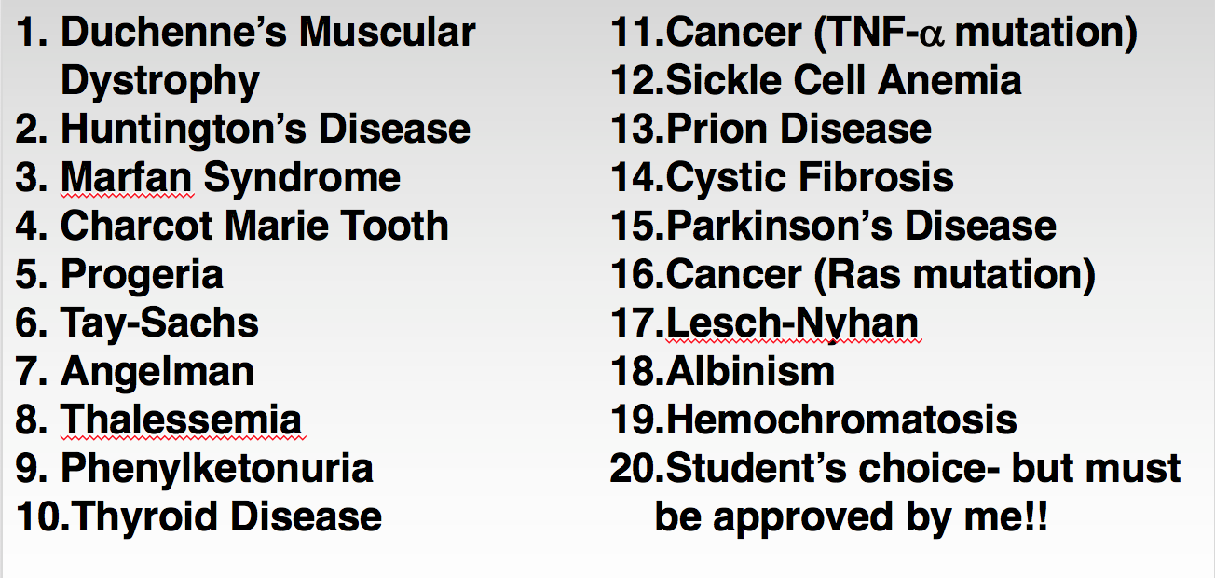
List of Possible Diseases to Study

Slide 3
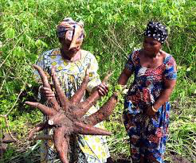
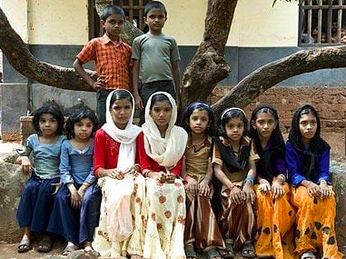
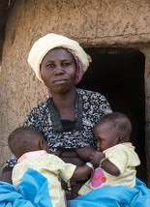
Fun genetics fact of day!
Small villages with ~4X higher rates of twin births than the rest of the world.
Igbo-Ora, Nigeria
North Kerala, India
Current theory: Both places have a diet high in Cassava root which may have a chemical that causes release of >1 egg at a time

Slide 4
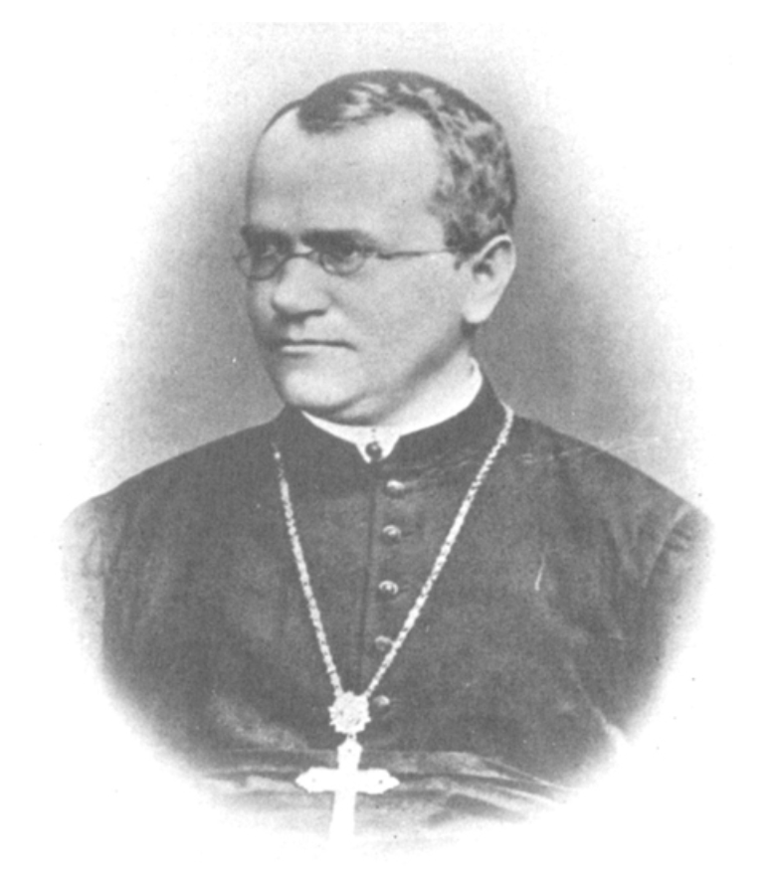
Mendelian Genetics
Dr. Keller
Chapter 14
Mr. Anderson’s Mendelian Genetics: https://www.youtube.com/watch?v=NWqgZUnJdAY
Mr. Anderson on Punnett Squares: https://www.youtube.com/watch?v=Y1PCwxUDTl8
Mr. Anderson on Chromosomal Inheritance: https://www.youtube.com/watch?v=KaxSDryqB6M

Slide 5
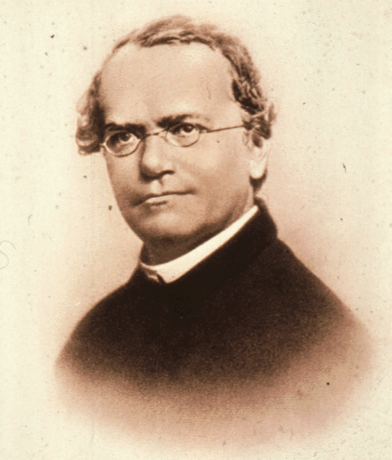
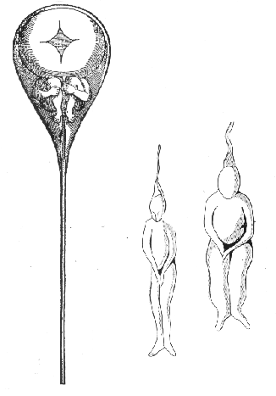
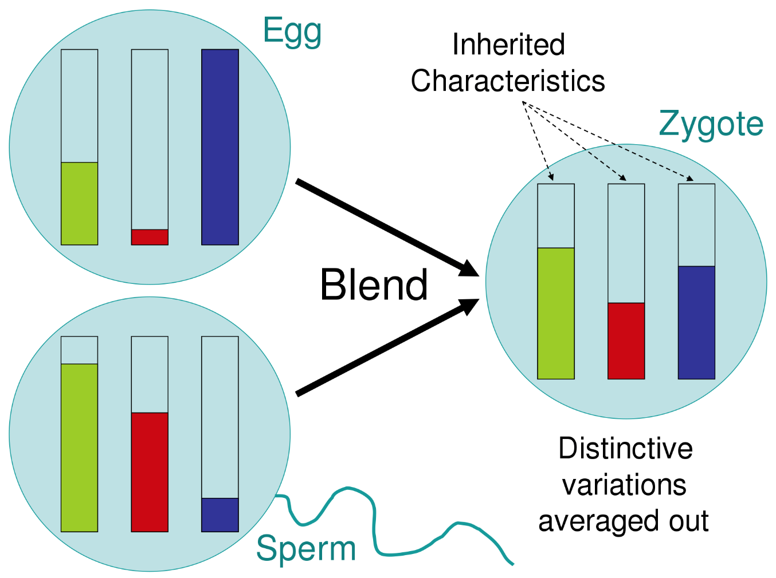
Why does genetics always begin with a discussion of Mendel and his famous pea plants?
Homunculus:
“little man” tucked into sperm
Blending Hypothesis
Johann Gregor Mendel (1822-1884)- The Father of Modern Genetics
Notes:
Johann Gregor Mendel (1822–1884). After he went to University he joined the monastery which was the cultural and intellectual hub of the region (instead of working on his father’s farm).
In 1856 – started 10-year research into patterns of inheritance .
Blending inheritance wasn't a formal, scientific hypothesis, but rather, an obverservational model in which inheritance involved the permanent blending of parents' characteristics in their offspring (producing offspring with an intermediate form of a characteristic

Slide 6
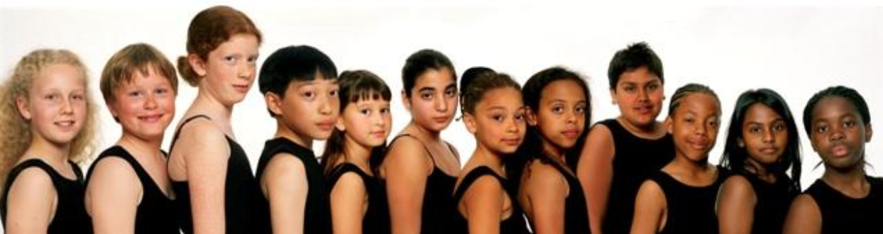
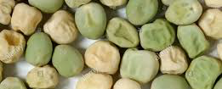
Mendel’s Model Systems to Study Genetics
Mice → honeybees → plants → PEAS!!
Humans are difficult to study
Complex traits
Slow growing
Small number of offspring (kids)
Unethical to set up “experiments” just to see what happens
Peas are easier to study
Simple traits (height, flower color, seed color, seed shape, etc.)
Grow quickly
Make many seeds
Can be bred on a controlled way
Discovered principles of inheritance that apply to many different kinds of organisms
Notes:
He was at St. Thomas's Abbey but his bishop did not like one of his friars studying animal sex
Bees (which were an aggressive variety) were an annoyance to monks and visitors

Slide 7
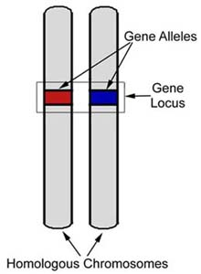
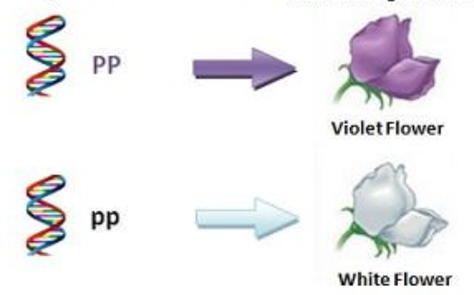
Inherited traits are caused by genes, transmitted from parent to offspring
Gene
A piece of DNA consisting of a specific nucleotide sequence that encodes for a protein
Allele
A version (specific sequence) of a gene that produces a distinguishable phenotype
Genotype (the DNA)
The set of alleles, of an organism. Diploid organisms have 2 alleles per gene.
Phenotype (the output)
The observable physical and physiological traits of an organism (determined by its genotype)

Slide 8
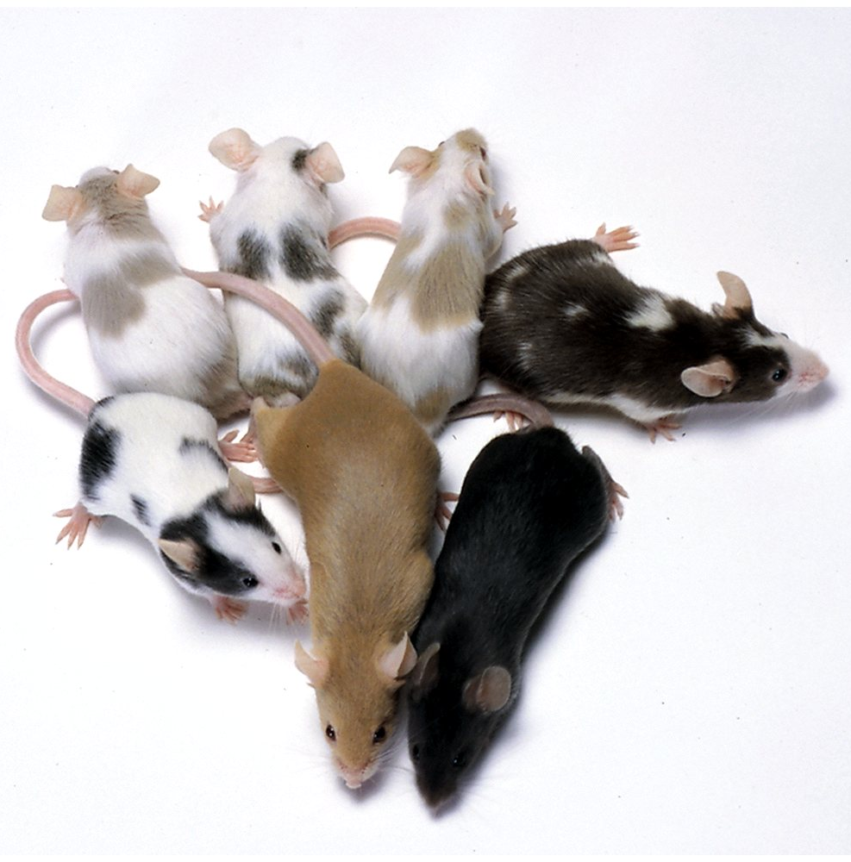
Genotype and phenotype are linked by the central dogma of molecular biology
Cc
cc
CC
allele
DNA
RNA
Protein

Slide 9
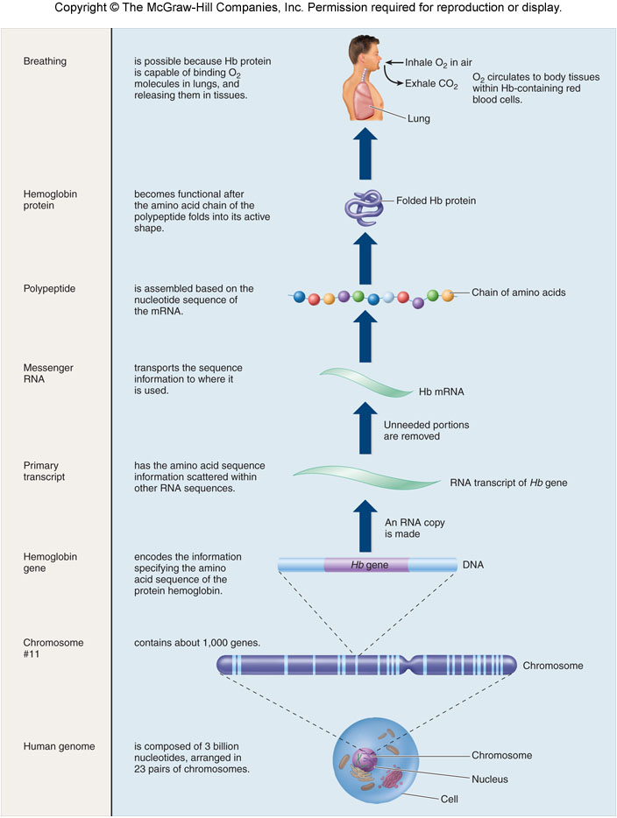

Slide 10
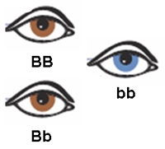
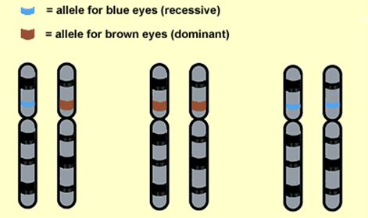
Genotype determines phenotype
Genotype
The sequence of DNA (alleles)
Two alleles for every gene
one from mom
one from dad
Each allele is symbolized by a letter (ex: BB, Bb, or bb)
Phenotype
Observable traits of an individual
Examples: eye color, flower color, plant height, etc.
Genotype determines phenotype:
BB = brown eyes
Bb = brown eyes
bb = blue eyes

Slide 11
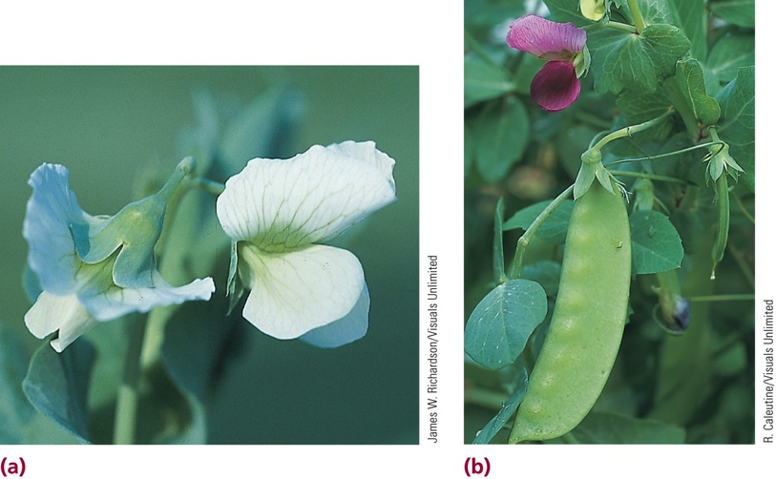
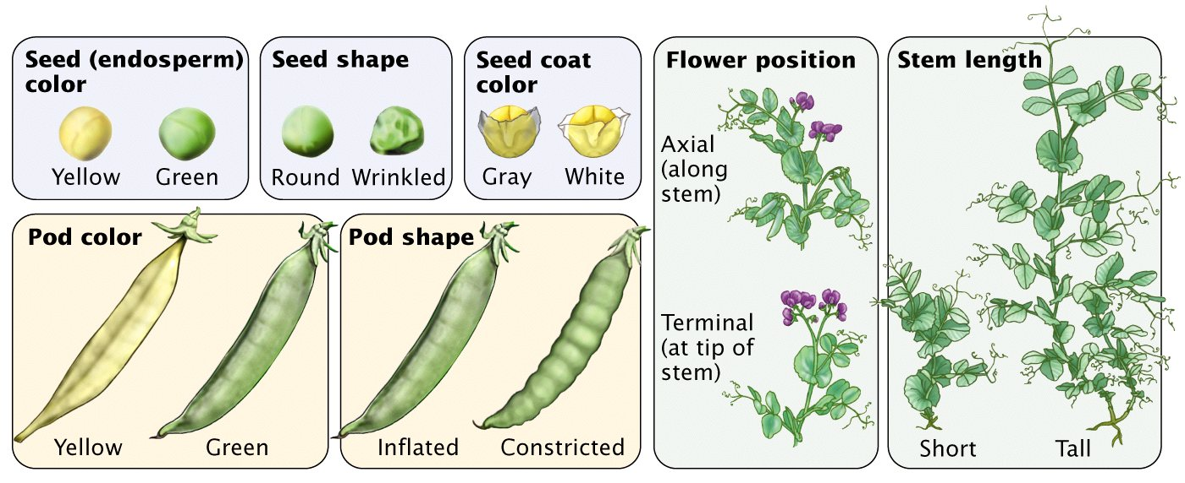
Mendel’s Experimental Design = LOTS of #s
VERY large numbers!!
EXPERIMENTAL QUESTION: When pea plants producing purple flowers are crossed
with pea plants producing white flowers, will the progeny peas be purple,
white, or a “blended” intermediate?

Slide 12
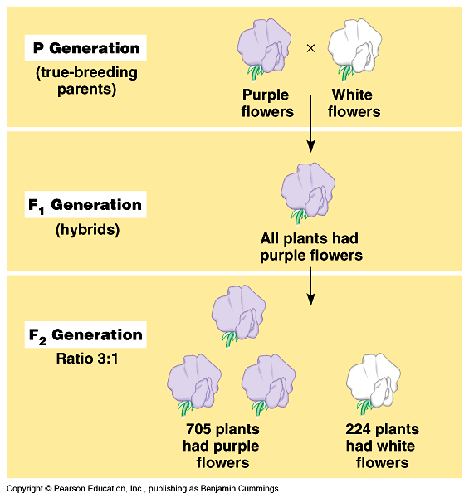
True-Breeding
Strains that when self-fertilized ONLY ever produced offspring with the same traits. Two copies of the same allele
(homozygous: PP or pp)
Hybrids
The result of a cross between two different true-breeding organisms. Offspring have a different genetic makeup than the parents
(heterozygous: Pp)

Slide 13
Mendel’s Experimental Design
Controlled mating following a single trait: Monohybrid Cross
Genetic Cross Terminology
P = parental generation
F1 = first generation
F2 = second generation
In this experiment
P = True breeding flowers
F1 = hybrids (all purple)
F2 = offspring of hybrid cross
Notes:
F = filial (from Latin words filius=son and filia=daughter)

Slide 14
Mendel’s Experimental Design
Studied well-defined traits
Counted the frequency of occurrence of the trait in successive generations
F1 generation:
P (purple): 100%
p (white): 0%
F2 generation:
P (purple): 705/929 = ~3/4 = 75%
p (white): 224/929 = ~1/4 = 25%

Slide 15
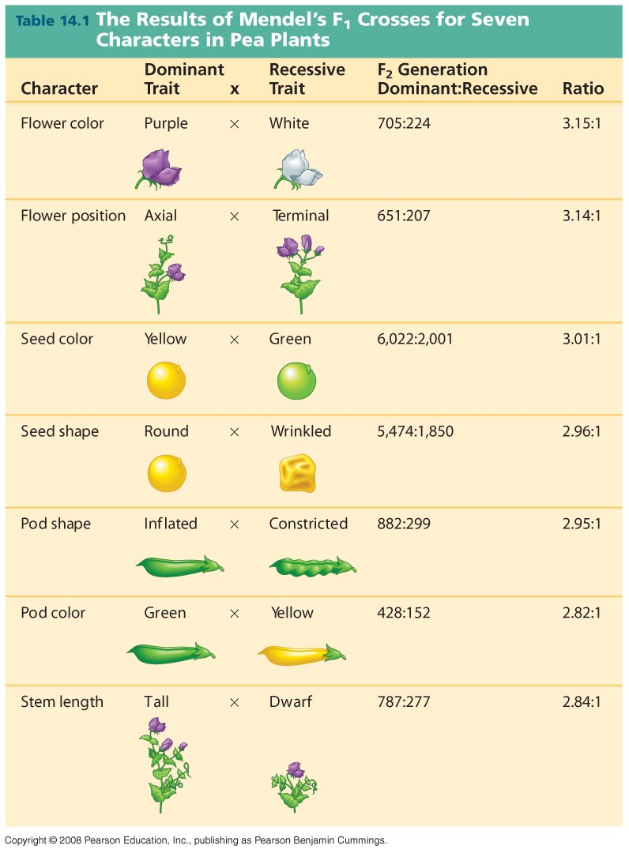
How did Mendel interpret his results?

Slide 16
Mendel’s Law of Segregation
The 2 alleles for each observable trait are separated during meiosis and packaged into gametes (what stage of meiosis??)
Haploid egg & sperm only have one copy of each gene
Meiosis & gametogenesis supports this law
Punnett square is used to predict offspring
Different genotypes (versions/alleles) give different phenotypes!
Notes:
Separated during anaphase of meiosis 1 (when homo chromos separate)
Phenotypic ratio: 3:1
Genotypic ratio: 1YY:2Yy:1yy
P(yellow): 3/4
P(green): 1/4
P(YY): 1/4
P(Yy): 1/2
P(yy): 1/4

Slide 17
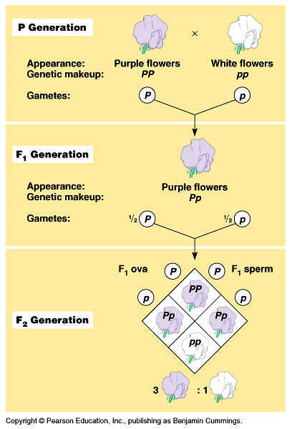
P generation (true-breeders)
Purple flowers (PP) → gametes P
White flowers (pp) → gametes p
F1 generation:
100% Purple flowers (Pp) →
Can give either gamete: P or p
F2 generation:
¾ Purple (genotype Pp)
¼ white (genotype pp)
Draw out Punnett Squares for P1 and F1 crosses!

Slide 18
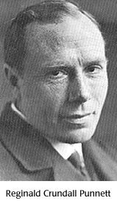
PUNNETT squares were invented to predict Mendelian genetics
male gametes
P
p
PP Pp
Pp pp
P
female
gametes
p
Genotypic ratio: ____ Phenotypic ratio: ____
Notes:
Genotypic Ratio: 1:2:1
Phenotypic Ratio: 3:1

Slide 19
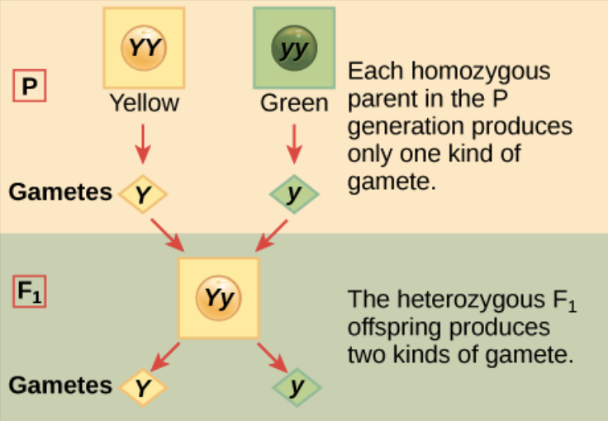
Do F2 Punnett Square!
What is the phenotypic ratio of the F2 progeny?
What is the genotypic ratio of the F2 progeny?
What is the chance of seeing the dominant phenotype?
What is chance of seeing recessive phenotype?
What is the chance for each genotype?

Slide 20
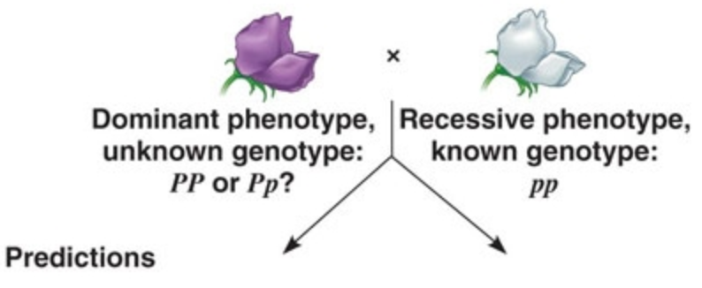
Dominant and Recessive Traits
Dominant
The expressed trait in the F1 generation (capital letter)
Recessive
The hidden trait in the F1 generation
(lowercase letter)
Use the letter representing the dominant phenotype
We know the phenotypes but not the genotype of the purple flower.
Do a TEST CROSS!!!
Cross it to a known genotype (like a true breeding white flower)
What would the two different predicted outcomes be?
Notes:
If PP → 100% purple flowers out
If Pp → 50% purple; 50% white flowers out

Slide 21
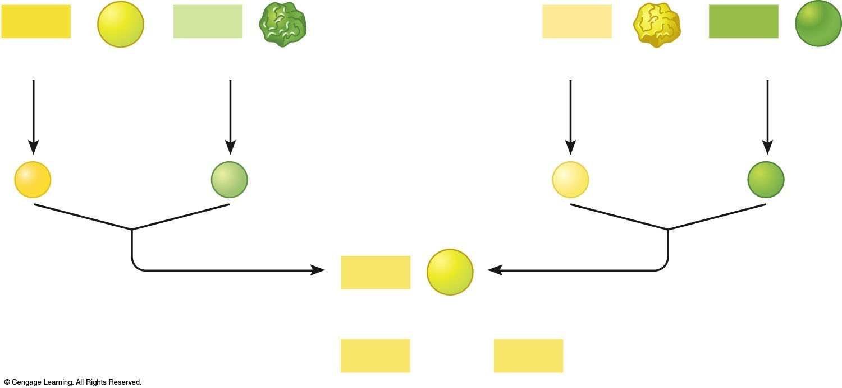
Dihybrid Crosses: Two genes/traits involved
What would the gametes be for the following pea genotypes:
Smooth yellow (SSYY) →
Wrinkled green (ssyy) →
Wrinkled yellow (ssYY) →
Smooth green (SSyy) →
Smooth yellow (SsYy) →
P₁ cross
P₁ cross
SSYY
ssyy
ssYY
SSyy
Smooth Yellow
wrinkled green
wrinkled Yellow
Smooth green
x
x
Gamete formation
Gamete formation
SY
sy
sY
Sy
Fertilization
Fertilization
SsYy
F₁ = Smooth Yellow
F₁ cross
SsYy
SsYy
DO ON BOARD!
Notes:
1. SY
2. sy
3. sY
4. Sy
5. SY, Sy, sY, sy
Both parent (P1) crosses result in 100% SsYy smooth yellow offspring!

Slide 22
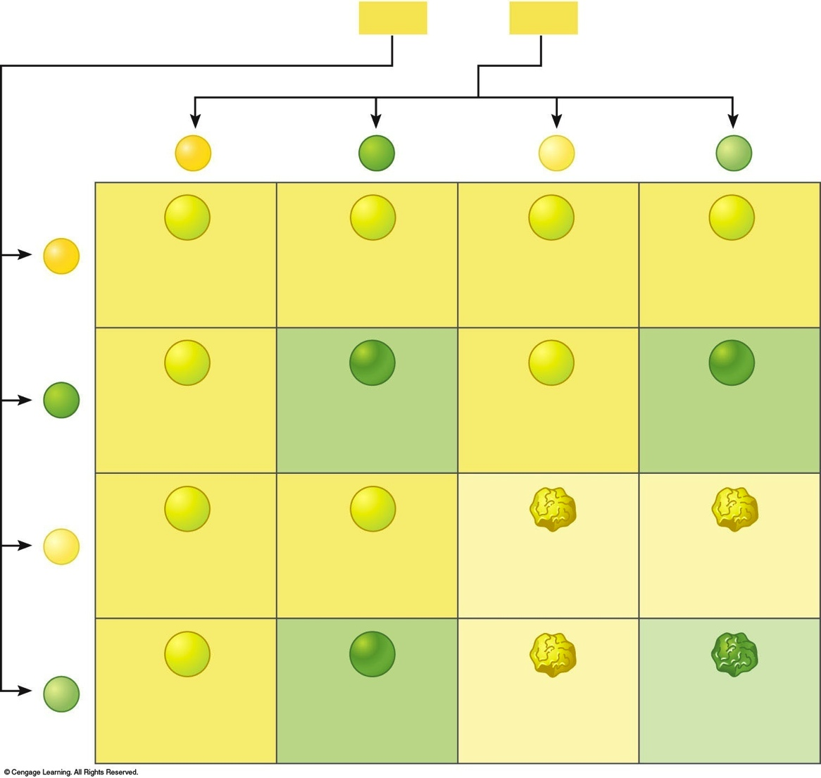
Dihybrid cross Punnett square (illustrates independent assortment during meiosis)
Now you can calculate genotypic and phenotypic ratios:
SsYy
SsYy
F₁ cross
x
SY
Sy
sY
sy
SY
SSYY Smooth Yellow
SSYy Smooth Yellow
SsYY Smooth Yellow
SsYy Smooth Yellow
F₂ Genotypic ratios
F₂ Phenotypic ratios
1/16
SSYY
Sy
2/16
SSYy
9/16 Smooth Yellow
SSYy Smooth Yellow
SSyy Smooth green
SsYy Smooth Yellow
Ssyy Smooth green
2/16
SsYY
4/16
SsYy
1/16
SSyy
3/16 Smooth green
2/16
Ssyy
sY
SsYY Smooth Yellow
SsYy Smooth Yellow
ssYY wrinkled Yellow
SsYy Smooth Yellow
1/16
ssYY
2/16
ssYy
3/16 wrinkled Yellow
1/16
ssyy
1/16 wrinkled green
sy
ssYy wrinkled Yellow
Ssyy Smooth green
ssYy wrinkled Yellow
ssyy wrinkled green
Phenotypic ratio from two heterozygous traits: 9:3:3:1

Slide 23
Mendel’s Second Law: The Principle of Independent Assortment
Each pair of alleles segregates independently of each other pair of alleles during gamete formation.*
*
rules apply only to genes on different chromosomes or genes widely spaced on the same chromosome
Inheritance of one trait does not affect inheritance of another trait

Slide 24
Mendel’s conclusions
Genetic factors “genes” can be hidden, therefore hybrids (heterozygotes) only express one trait
Despite identical appearance, P1 and F1 plants must have similar/different genetic factors
The trait not expressed in the F1 plants reappeared in the F2 plants
The two big ideas:
Heredity is determined by discrete physical elements for each trait (genes!)
Diploid genes are separated during gamete production (meiosis) and regrouped in offspring (fertilization) in a logical and predictable way

Slide 25
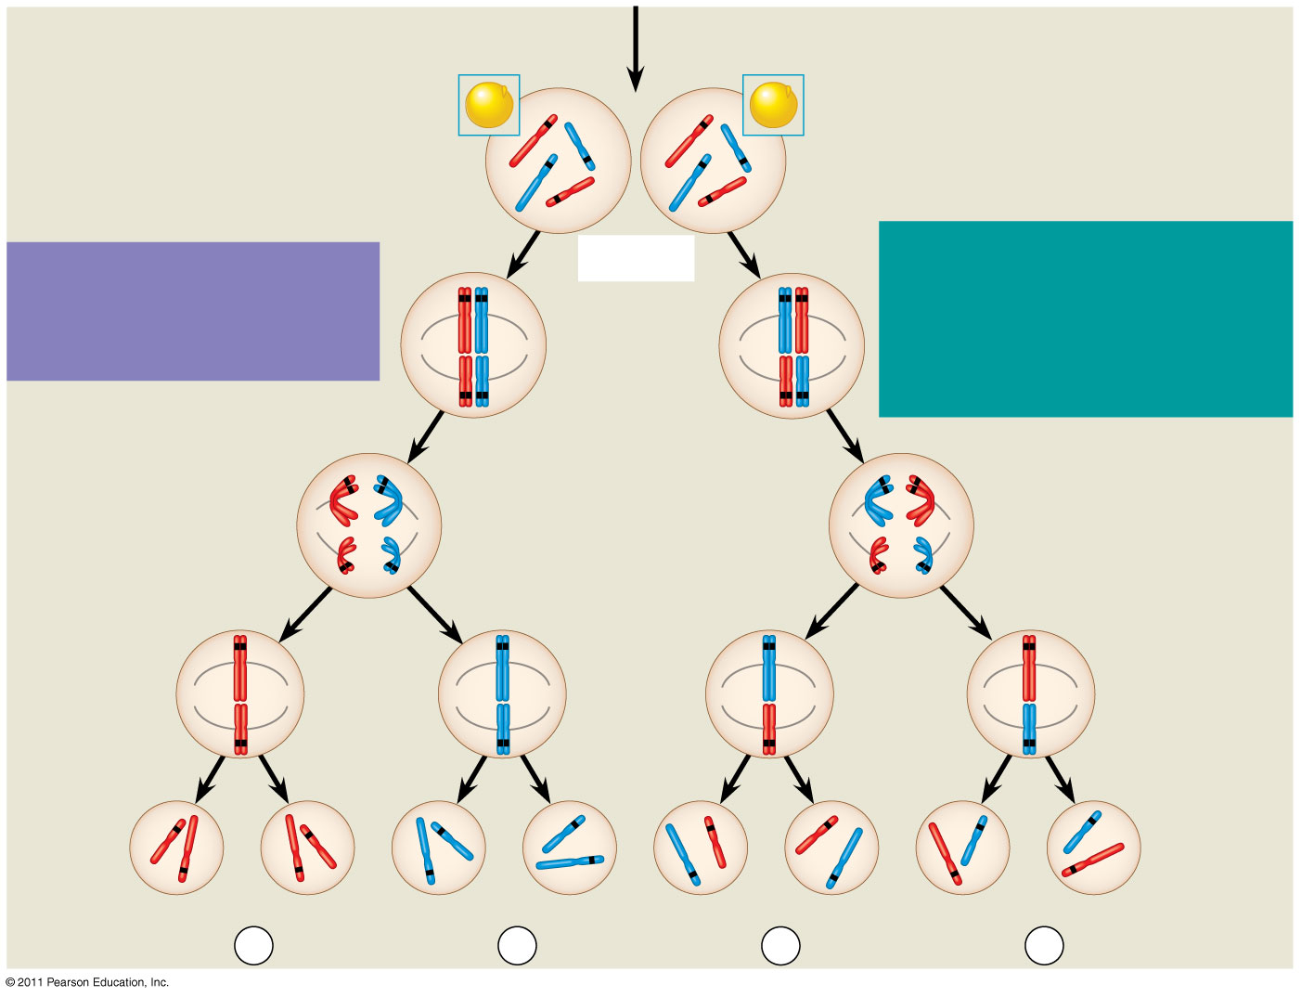
Figure 15.2b
All F₁ plants produce yellow-round seeds (YyRr )
F₁ Generation
R
R
r
y
r
y
Y
Y
Meiosis
LAW OF INDEPENDENT ASSORTMENT Alleles of genes on non-homologous chromosomes assort independently during gamete formation.
LAW OF SEGREGATION The two alleles for each gene separate during gamete formation.
R
r
r
R
Metaphase I
Y
y
Y
y
1
1
R
r
r
R
Anaphase I
Y
y
Y
y
R
r
Metaphase II
r
R
2
2
Y
y
Y
y
Y
Y
y
y
Y
Y
y
y
Gametes
r
R
R
r
r
r
R
R
¹/₄
YR
¹/₄
yr
¹/₄
Yr
¹/₄
yR
Notes:
Figure 15.2 The chromosomal basis of Mendel’s laws.

Slide 26
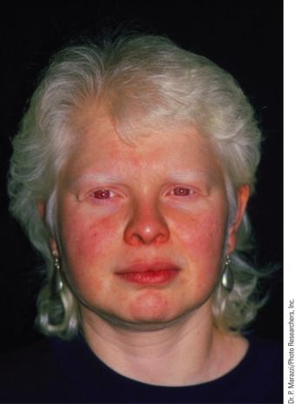
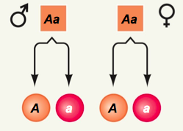
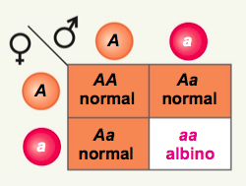
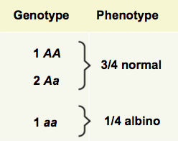
Mendelian inheritance in humans (one trait)
Inheritance of certain human traits is predictable based on Mendelian inheritance patterns
Albinism
What are the gametes produced by each parent?
What percent of the normal offspring will be carriers of the disease?
Notes:
2/3
What if this was a fatal disease like Tay Sachs… what is the chance that the offspring of two hets is a carrier for the disease? 2/3

Slide 27
Dihybrid Cross
Gene for Pigmentation:
Two possible alleles
A (normal pigmentation)
a (albino)
Gene for Hearing:
Two possible alleles
D (normal hearing)
d (deafness)
What is the probability that a couple heterozygous for both genes will have an albino, deaf child? Determine gametes first!
Remember that result of two heterozyotes in a dihybrid cross result in a 9:3:3:1 phenotypic offspring ratio
Determine the probability of each trait separately first
¼ x ¼ = 1/16

Slide 28
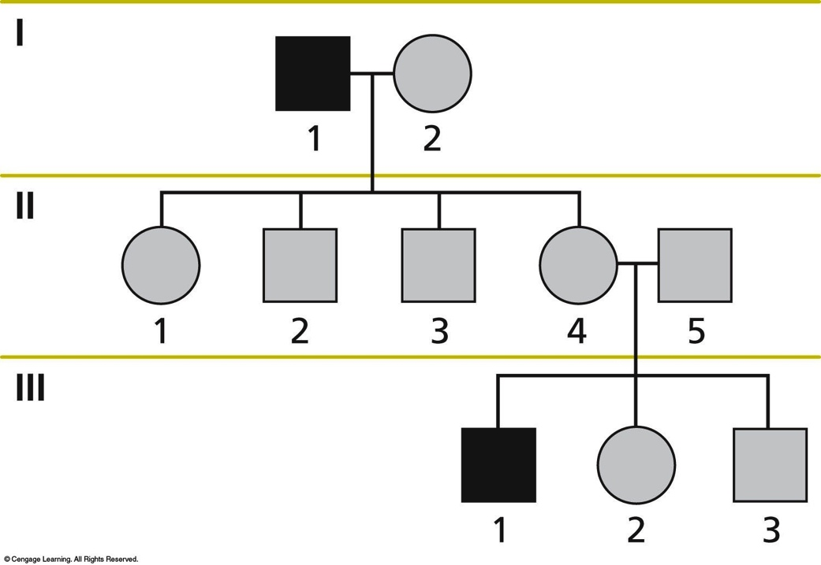
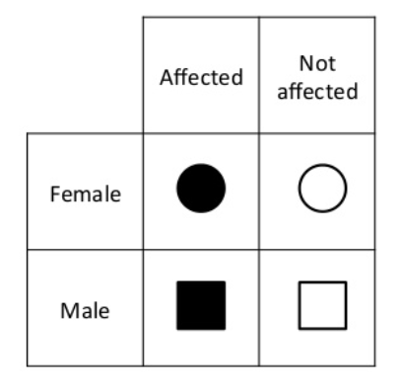
Mendelian genetics in humans
Mendelian genetics can be described by a pedigree analysis of generations of a family
An affected grandpa had 4 kids. His fourth child had an affected first born.

Slide 29
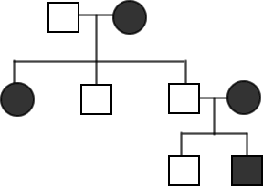
Pedigrees with Mendelian Genetics
The trait being studied is tongue rolling ability, which is dominant. Those who cannot roll their tongue are recessive (tt).
Determine the genotypes of all individuals in the pedigree.
If the circled individual had babies with a heterozygous female what is the chance of them having a tongue-rolling baby?
Notes:
tt ; Tt
Tt ; tt ; tt X Tt
Tt ; Tt
- 50% (tt X Tt)

Slide 30
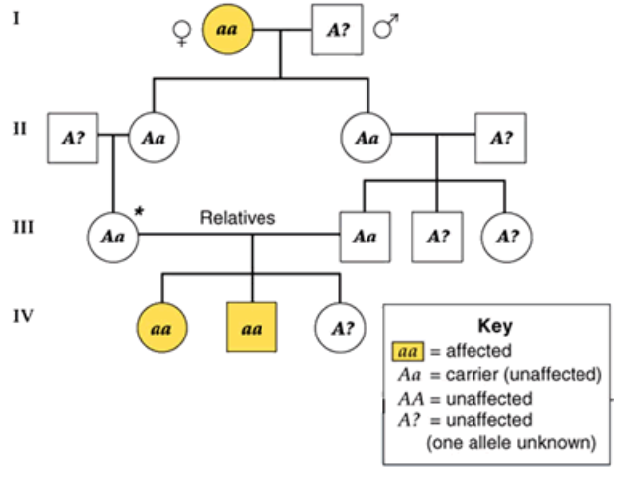
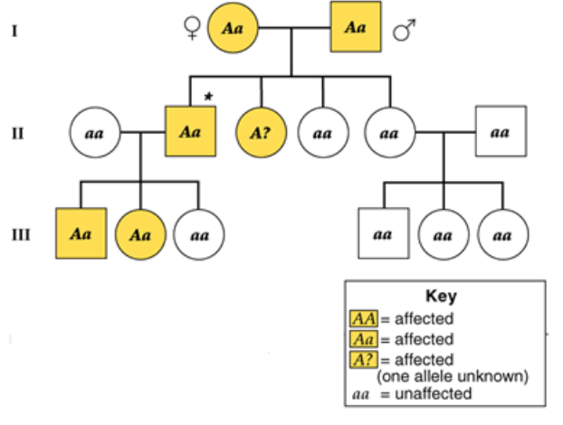
Pedigrees with Mendelian Genetics
Some traits like Achodroplasia (Dwarfism) are a dominant trait: DD or Dd → dwarfism; dd → normal height
If a trait is recessive it skips a generation.
If a trait is dominant it doesn’t skip a generation.
In rare recessive diseases, mating within a family (consanguineous) increases the risk of a recessive disease popping up between two carriers!

Slide 31
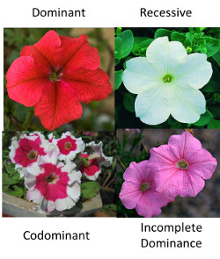
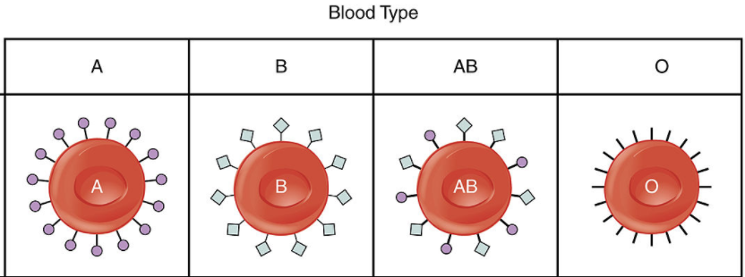
Variations from Mendel
Alleles can interact in ways other than dominant or recessive:
Incomplete Dominance
Codominance
Multiple alleles
Incomplete Dominance
Offspring have an intermediate (mixed) phenotype
Codominance
Two alleles each affect the phenotype in different ways
Multiple Alleles
When there are more than two alleles in the population

Slide 32
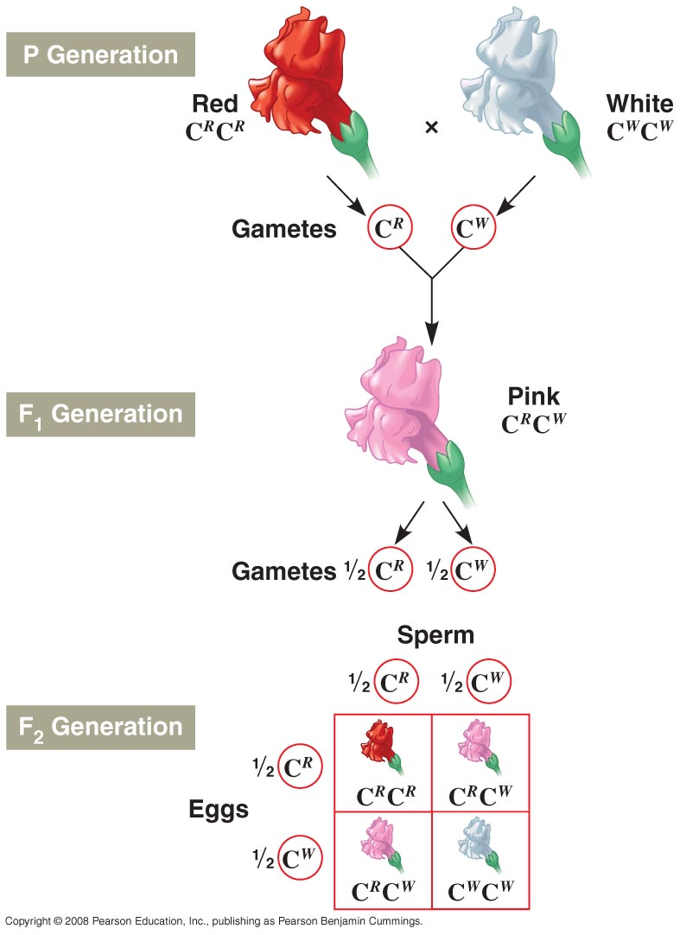
Incomplete Dominance
The expression of a phenotype that is intermediate to those of the parents.
An example is the inheritance of snap dragon colors:
RR (red) X WW (white) = RW (pink)
Notes:
Human genetics thought to involve incomplete dominance:
Nose size
Hair color
Eye brown position
Face shape
Mouth size
Ear size

Slide 33
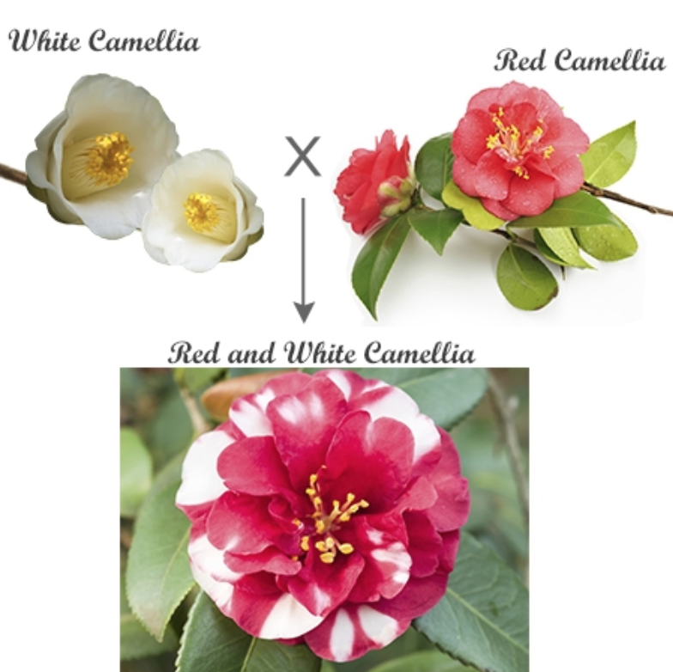
Codominance
Full phenotypic expression of both members of a heterozygous gene pair.
The two alleles are BOTH dominant

Slide 34
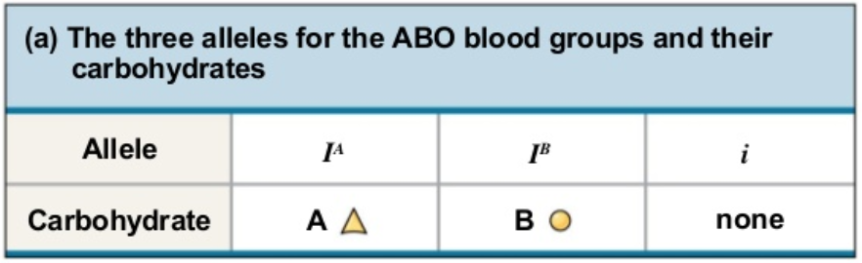
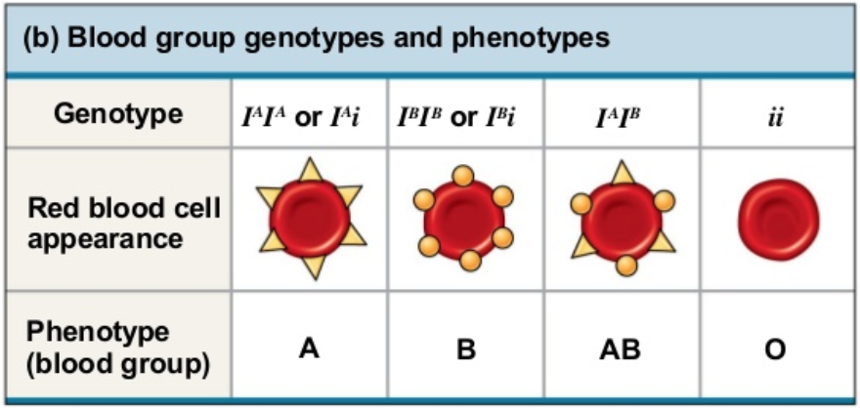
Multiple Alleles
Genes that have more than two alleles in a population (still only two within each individual person)
Example: The inheritance of the ABO blood types in humans
Universal donor?
Universal acceptor?
Notes:
Sugars (glycoproteins – added by the golgi) on the surface of the RBCs
Universal Donor- O (no antigens to react with)
Universal Acceptor- AB (both antigens so could accept all types)

Slide 35
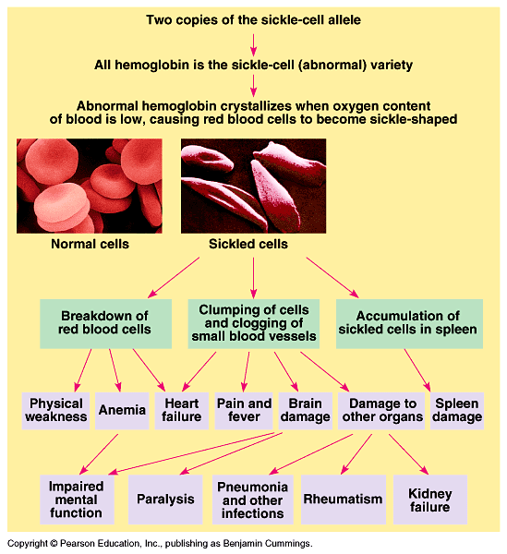
Pleiotrophy Inheritance
When a single gene has multiple phenotypic effects
Examples: cystic fibrosis and sickle cell anemia
Many human diseases in which only one gene is mutated can still cause wide-spread effects
Notes:
pleio- also pleo-, word-forming element meaning "more," from Greek pleion "larger, greater in quantity, the more part, very many" (comp.

Slide 36
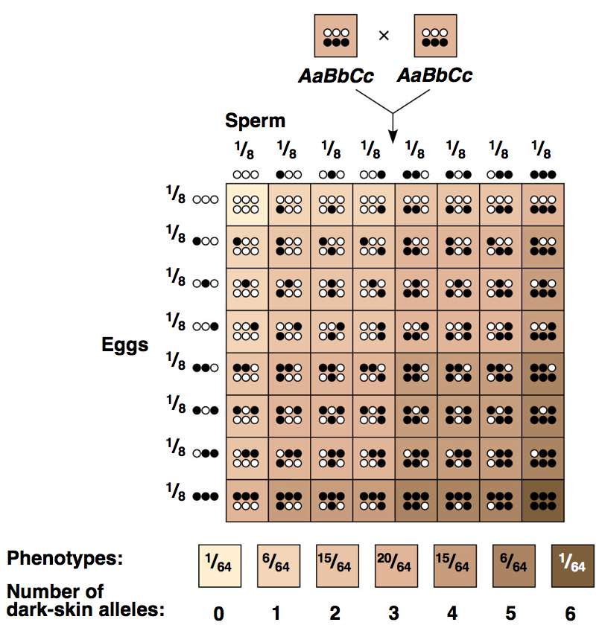
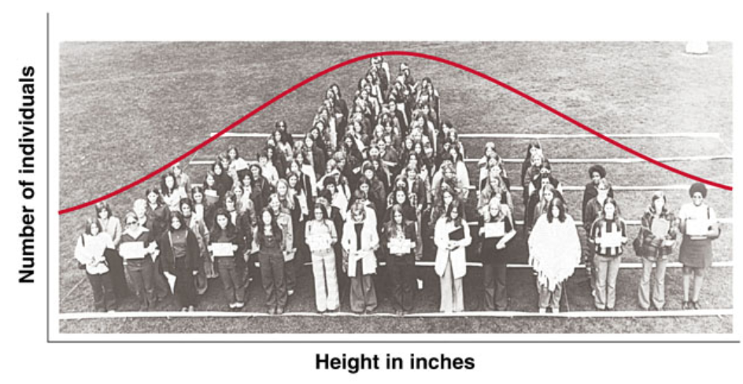
Polygenic Inheritance
An additive effect of two or more genes on a single phenotypic character
Gives a continuous (bell-curved) variation
Examples: human height and skin color
Polygenic inheritance results in bell-shaped curve of phenotypes
Notes:
Gametes from AaBbCc: ABC, Abc, AbC, aBC, aBc, Abc, abC, abc (8 types of gametes possible)

Slide 37
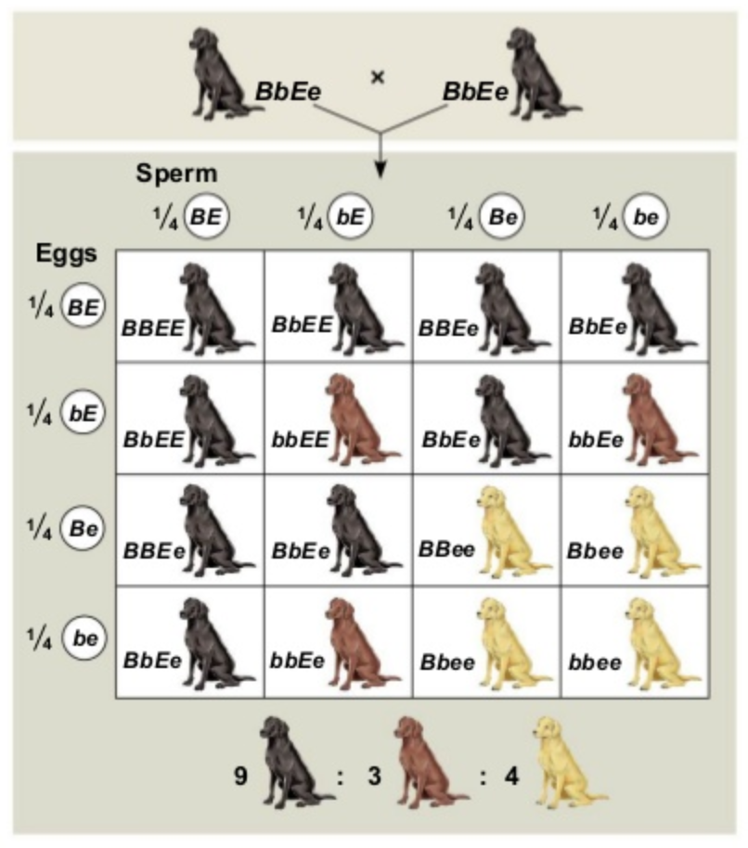
Epistasis
The phenotypic expression of a gene at one locus alters (masks) that of a gene at a second genetic location
Example: coat color in Labrador retrievers
Mate two heterozygous black labs:
What is expected ratio from a dihybrid cross with two heterozygotes?
Get a different ratio!
Must have a dominant E in order to have any color (it deposits pigment in fur)
Notes:
Expect a 9:3:3:1 from heterozygous dihybrid cross

Slide 38
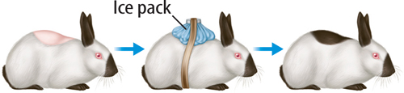
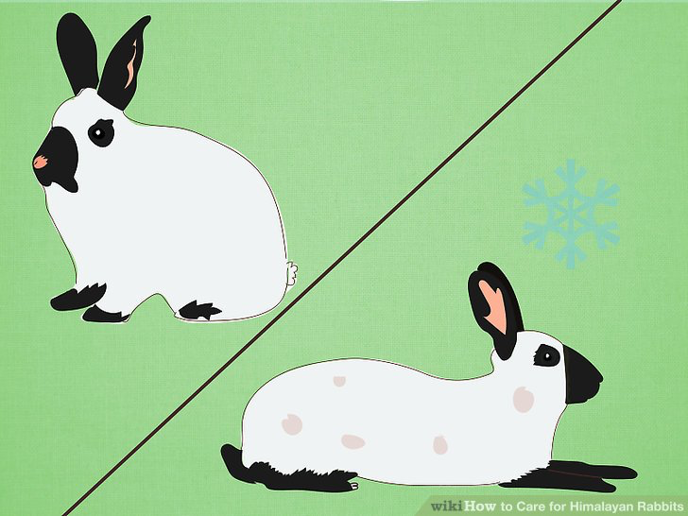
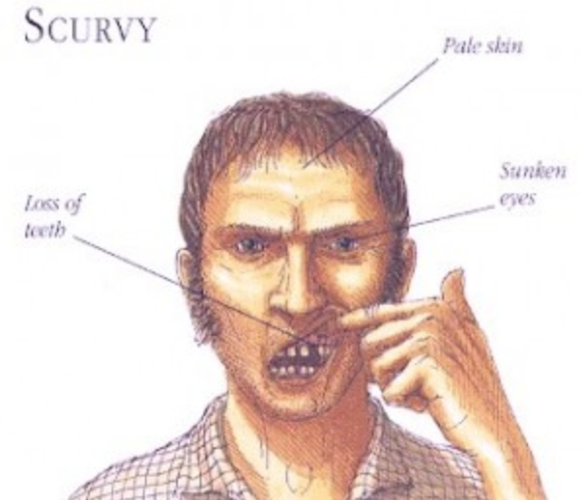
Nature (genes) vs. Nurture (environment)
Himalayan rabbit are homozygous for an allele that specifies a heat-sensitive version of an enzyme in the melanin-producing pathway
Melanin is produced ONLY in cooler areas of the body
Almost all human disease have both a genetic and environmental component. Very few (like scurvy) are completely environmental!
Notes:
Scurvy: a disease caused by a deficiency of vitamin C, characterized by swollen bleeding gums and the opening of previously healed wounds, which particularly affected poorly nourished sailors until the end of the 18th century.

Slide 39
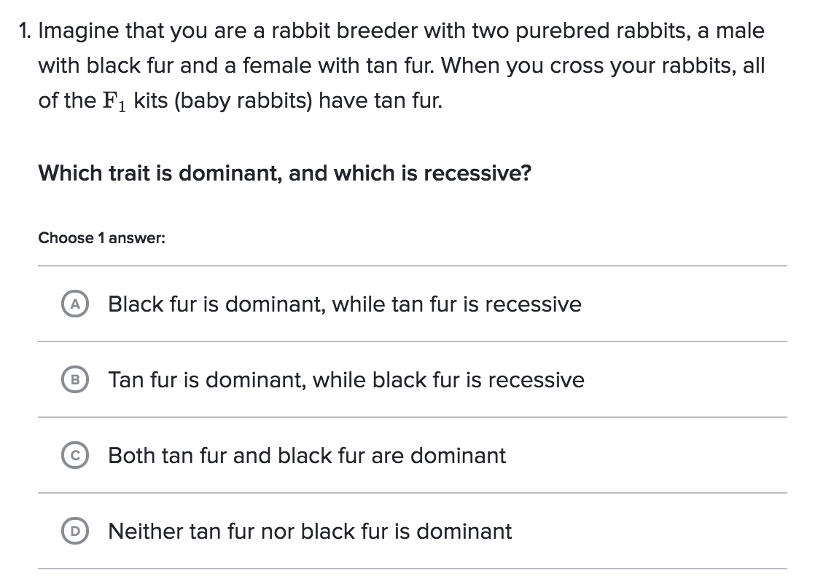
Practice Problems
Notes:
B

Slide 40

Practice Problems
Notes:
C

Slide 41

Practice Problems
Notes:
E

Slide 42

Practice Problems
Notes:
A

Slide 43

Practice Problems
Notes:
D

Slide 44

Practice Problems
Notes:
E

Slide 45

Practice Problems
Notes:
D

Slide 46
Practice Problems
Notes:
D

Slide 47

Practice Problems
Notes:
B

Slide 48

Practice Problems
Notes:
E

Slide 49

Practice Problems
Notes:
B

Slide 50

Practice Problems
Notes:
C

